Slide 1
Predicting Patient Readmission Using Machine Learning
Aditya Degree College, Palakollu
Team members: K.N.V.Narshini Durga(Team Lead)
K.Nikitha Devi
V.J.P.Prasana
M.Indira

Slide 2
Introduction
Overview:
Hospital readmission is a crucial concern in healthcare, impacting both patient outcomes and hospital costs.
Predicting readmission can help improve patient care and optimize resource allocation.
Objective of the Project:
To develop a machine learning model that predicts the likelihood of patient readmission.
Identify key factors that contribute to readmission.
Significance of the Study:
Helps hospitals reduce unnecessary readmissions.
Improves patient treatment plans and resource management.
Supports better decision-making in healthcare.

Slide 3
Problem Statement
What is the Problem?
Unplanned patient readmissions within a short period after discharge pose a significant challenge in healthcare.
Readmissions can indicate poor initial treatment, improper discharge planning, or lack of follow-up care.
Why is it Important?
High readmission rates lead to increased healthcare costs and burden hospitals.
They negatively affect patient recovery and hospital reputation.
Many readmissions are preventable with better predictive models.
Goal of the Project:
Build a machine learning model that predicts whether a patient will be readmitted based on past medical records.
Help healthcare providers take proactive measures to reduce readmissions.

Slide 4
Dataset Description:
The dataset contains patient records, including demographics, medical history, and hospital visit details.
It includes information such as age, diagnosis, treatment history, length of stay, and past readmissions.
Source of Data:
[ HEALTH CARE DATASET FROM KAGGLE ]
Key Features:
Patient Information: Age, gender, medical conditions
Hospitalization Details: Length of stay, number of previous visits
Medical Factors: Diagnosis codes, prescribed medications, lab test results
Outcome Variable: Readmission (Yes/No) – The target variable for prediction
Data Preprocessing Steps:
Handling missing values and outliers
Encoding categorical variables
Feature scaling and transformation

Slide 5
EXPLORATORY DATA ANALYSIS (EDA) - OVERVIEW

Slide 6
Purpose of EDA:
Understand the dataset’s structure
Identify patterns and relationships between features
Detect missing values and outliers
Key Insights Explored:
Distribution of patient readmissions
Age distribution of patients
Correlation between variables
Relationship between hospital stay and readmission

Slide 7
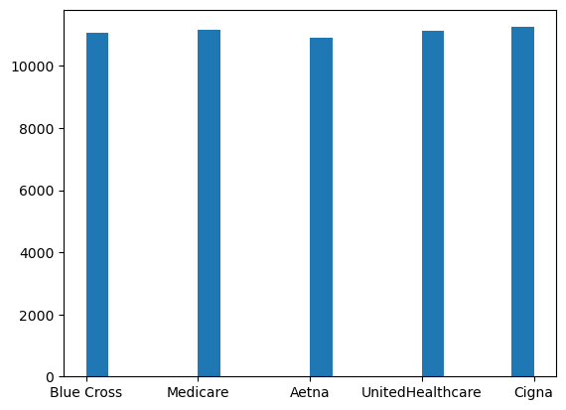
BARPLOT It Shows the proportion of patients who were readmitted vs. not readmitted. Helps understand the imbalance in the dataset.

Slide 8
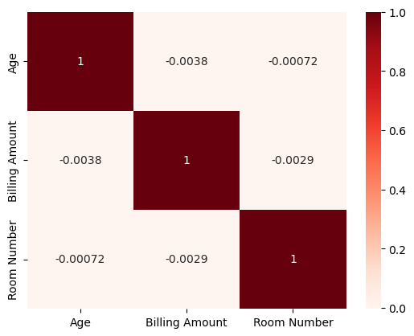
HEATMAP:
Displays the age distribution of patients. Helps in identifying if specific age groups are more prone to readmission.

Slide 9
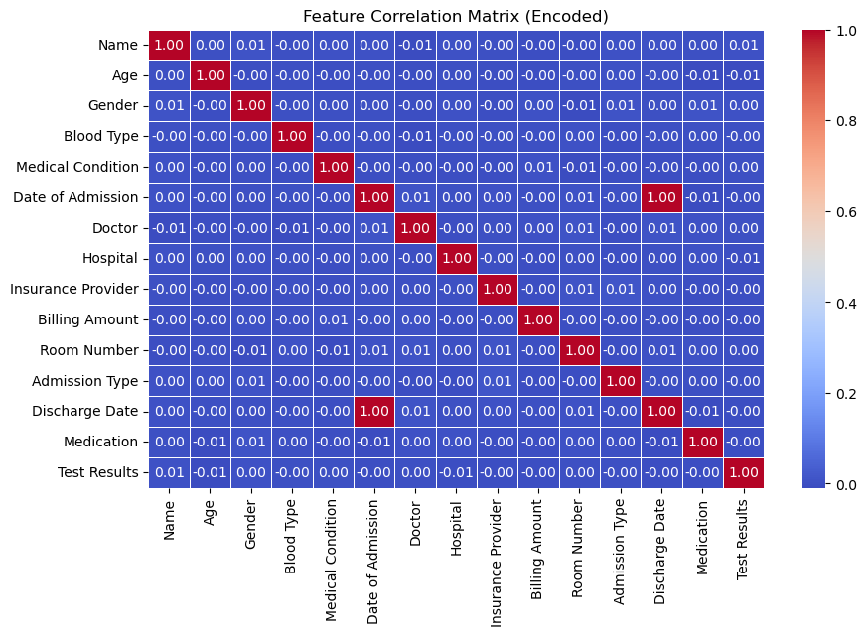
CORRELATION HEATMAP:
Highlights relationships between numerical features.
Helps in feature selection and engineering.

Slide 10
Feature Engineering
What is Feature Engineering?
Transforming raw data into meaningful features to improve model performance.
Helps the model learn patterns better and make accurate predictions.
Key Steps in Feature Engineering:
Handling Missing Values – Imputing missing data using mean, median, or mode.
Encoding Categorical Variables – Converting non-numeric features into numerical values (e.g., One-Hot Encoding, Label Encoding).
Feature Scaling & Normalization – Standardizing numerical features to a common scale.
Creating New Features – Deriving useful features, such as the average length of hospital stays or number of previous readmissions.
Feature Selection – Keeping only the most relevant features to avoid overfitting.
Example:
Original Feature: Categorical column like "Medical Specialty" (Cardiology, Neurology, etc.).
Transformed Feature: One-hot encoded columns: Cardiology → (1,0), Neurology → (0,1), etc

Slide 11
Model Evaluation
Selected Model: Random Forest Classifier
After testing multiple models, Random Forest was chosen for its high accuracy and ability to handle imbalanced data.
It effectively captures non-linear relationships and reduces overfitting.
Confusion Matrix
Displays correct vs. incorrect predictions for both readmitted and non-readmitted patients.
Helps analyze false positives and false negatives.
Key Insights ✔ High accuracy but might have class imbalance issues. ✔ Feature Importance Analysis shows key factors affecting readmission. ✔ Model can be further optimized using hyperparameter tuning.

Slide 12
Conclusion & Future Work
Conclusion
Successfully built a machine learning model to predict patient readmission based on healthcare data.
Random Forest Classifier was chosen due to its high accuracy and robustness.
Key factors influencing readmission were [mention top features, e.g., length of stay, age, previous admissions, etc.].
The model provides valuable insights for hospital management to reduce readmission rates.
Challenges Faced
Imbalanced Data: Readmitted cases were fewer, requiring balancing techniques.
Feature Selection: Identifying the most important predictors.
Overfitting: Handled using hyperparameter tuning and cross-validation.
Future Improvements Enhancing Data Quality – Adding more patient details like medication history. Using Deep Learning – Exploring neural networks for better performance. Deploying the Model – Integrating with hospital systems for real-time predictions.

Slide 13


